Slide 1
.NET MAUI框架
(Multi-platform App UI)

Slide 2
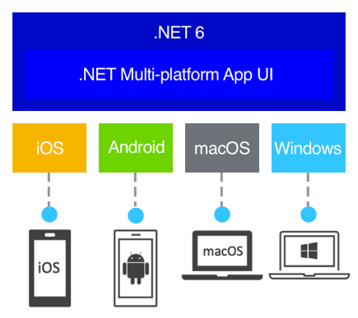
.NET MAUI is a cross-platform framework for creating native mobile and desktop apps with C# and XAML

Slide 3

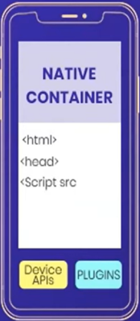

What kind of App Development to Choose?
WEB APP
HYBRID APP
NATIVE APP

Slide 4
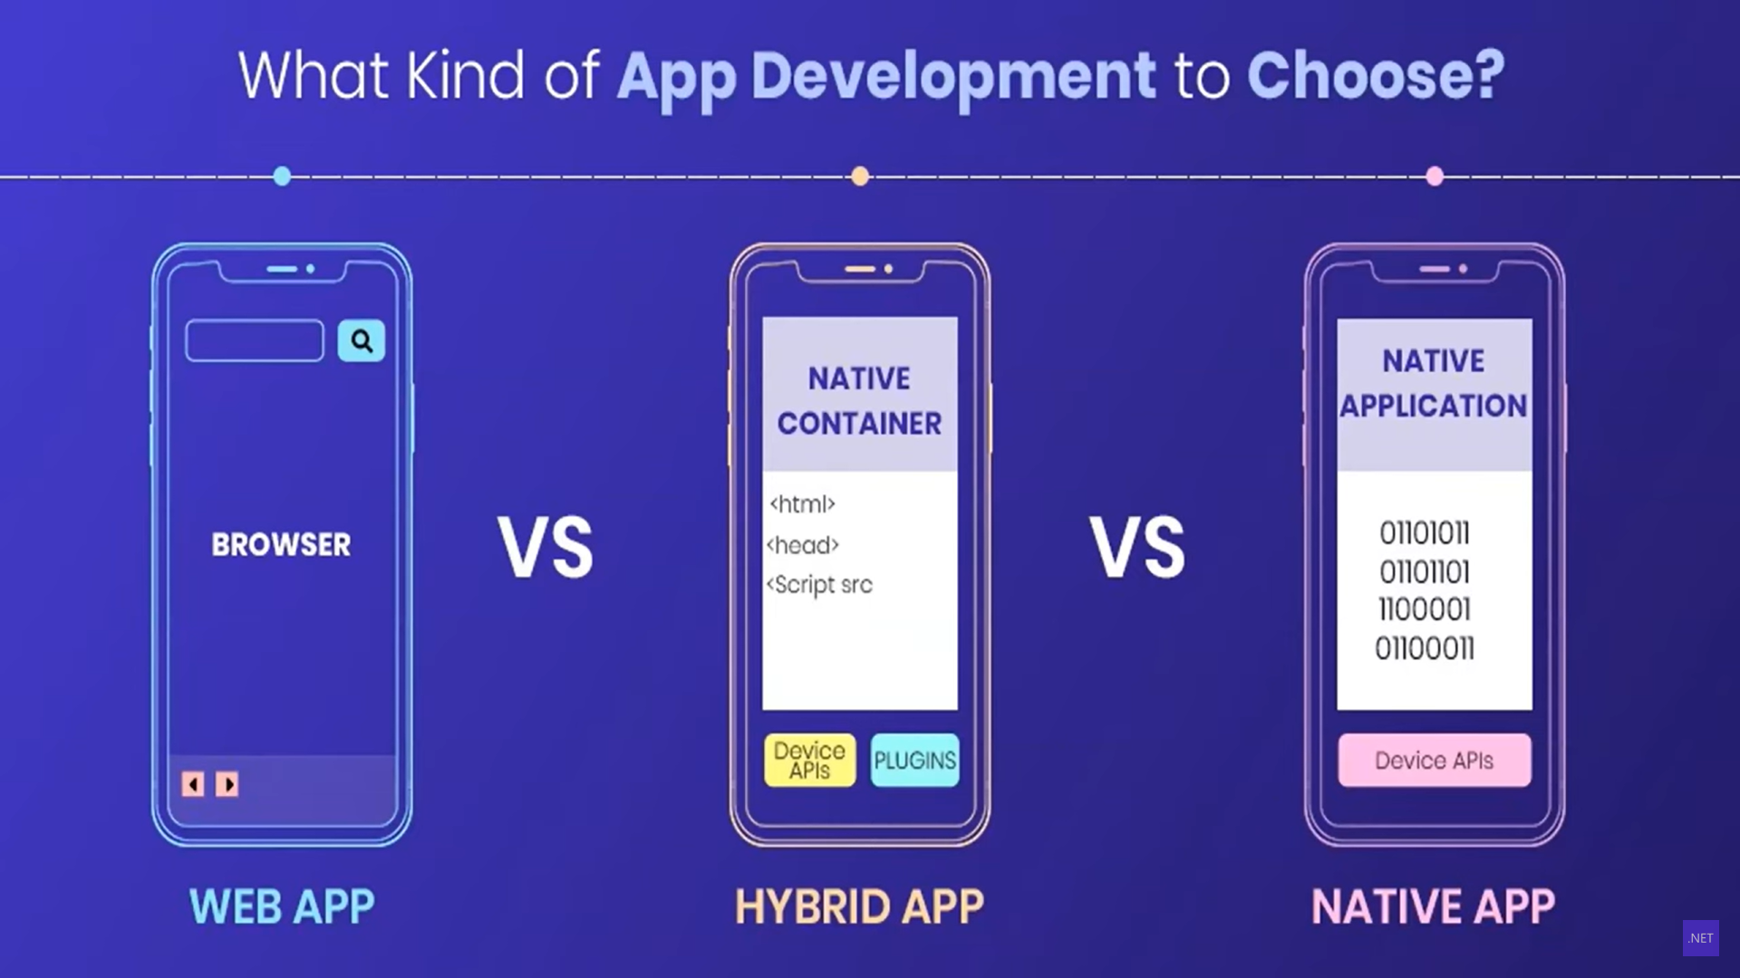

Slide 5
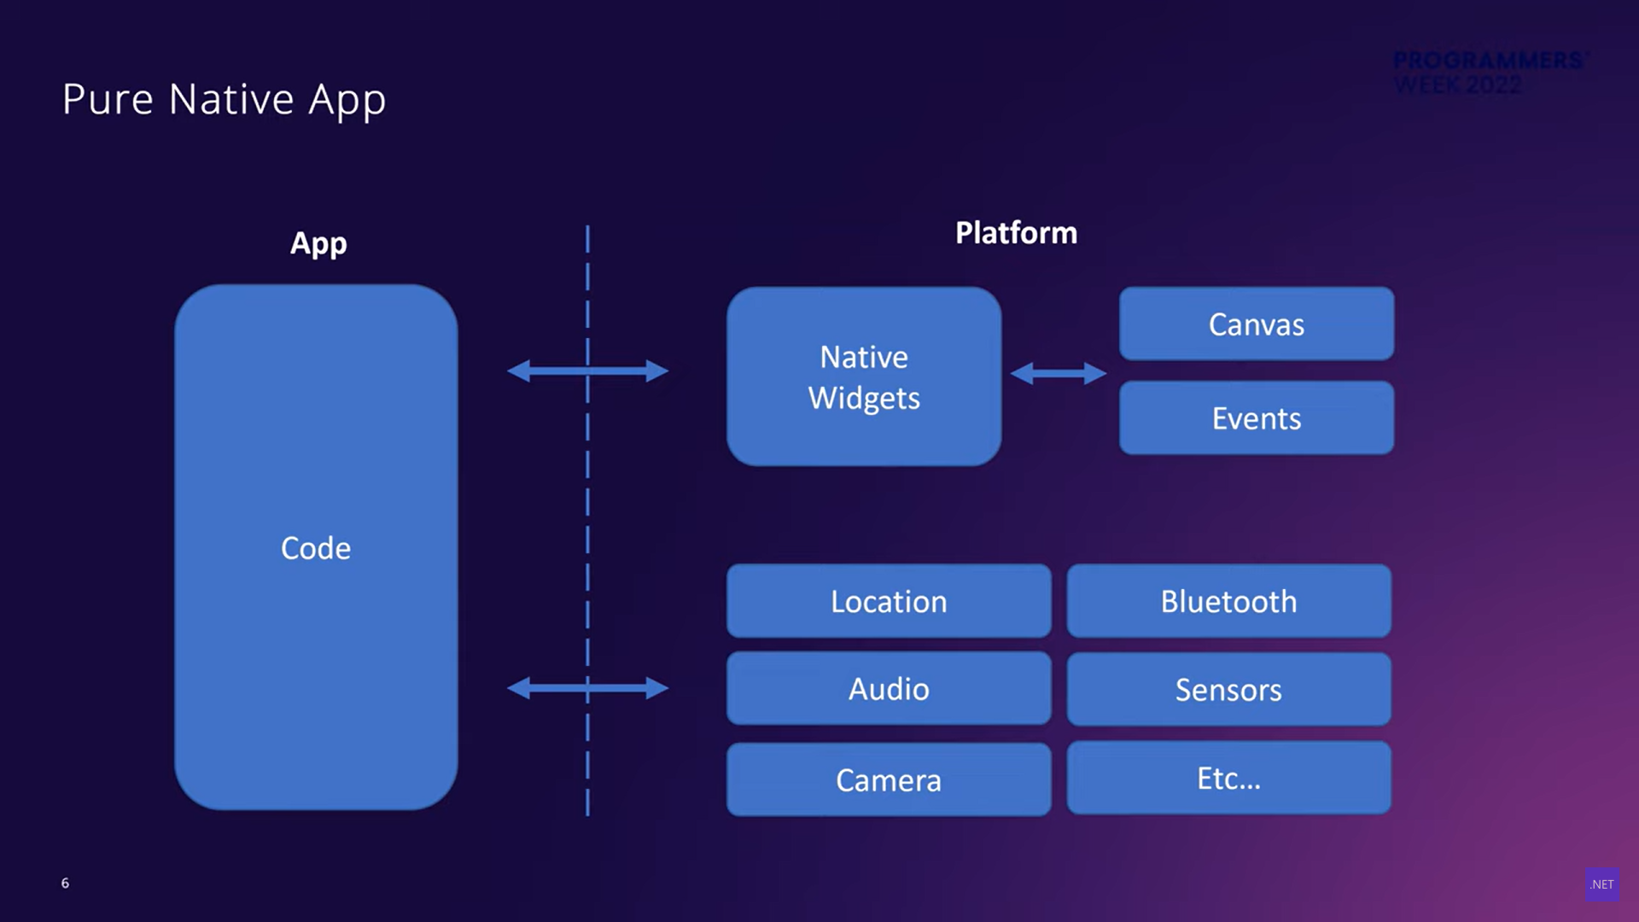

Slide 6
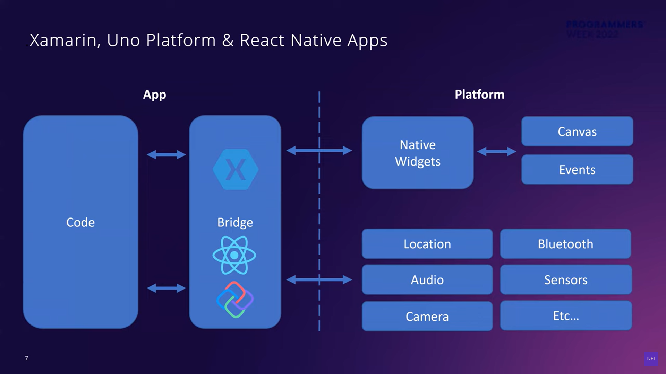

Slide 7
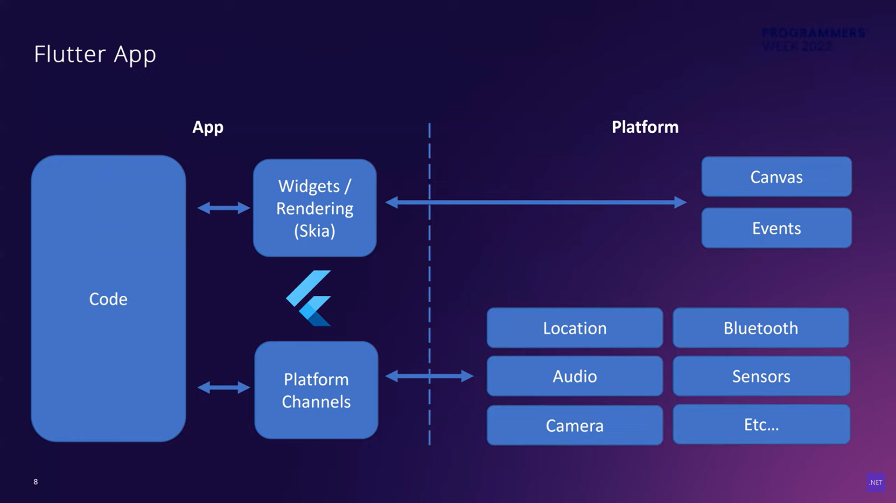

Slide 8
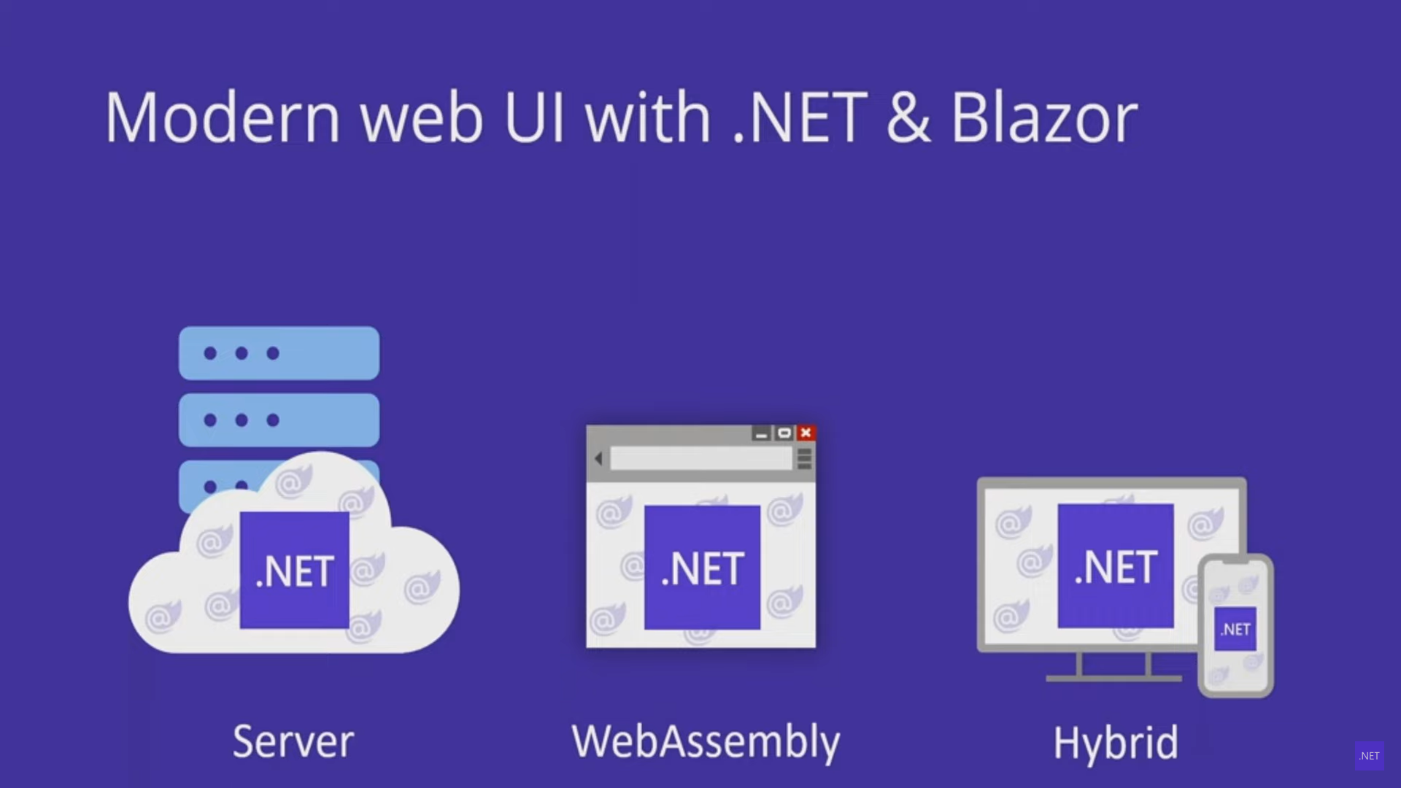

Slide 9
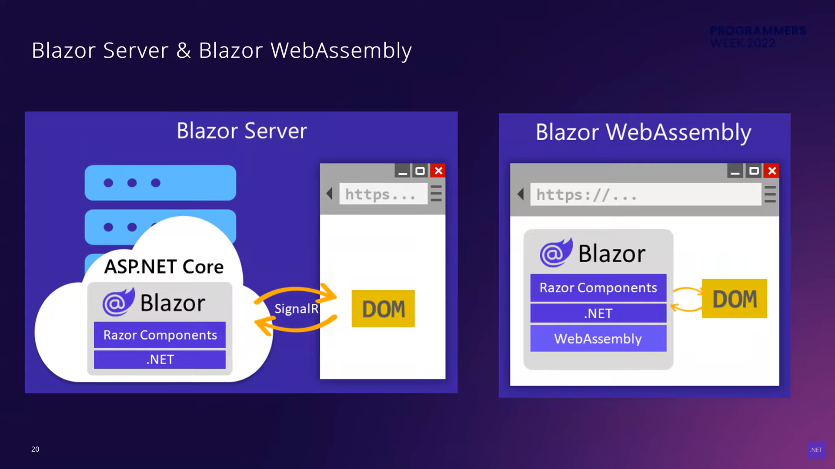

Slide 10
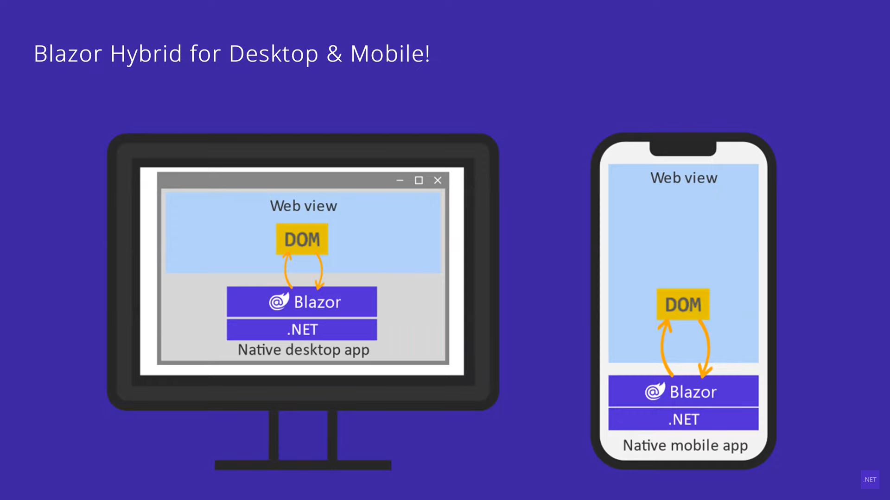

Slide 11
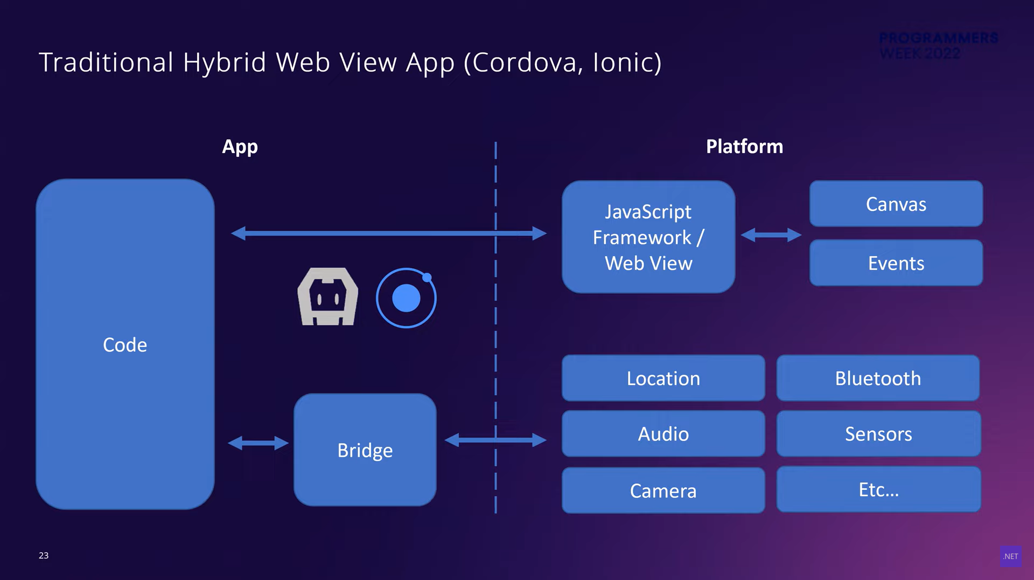

Slide 12
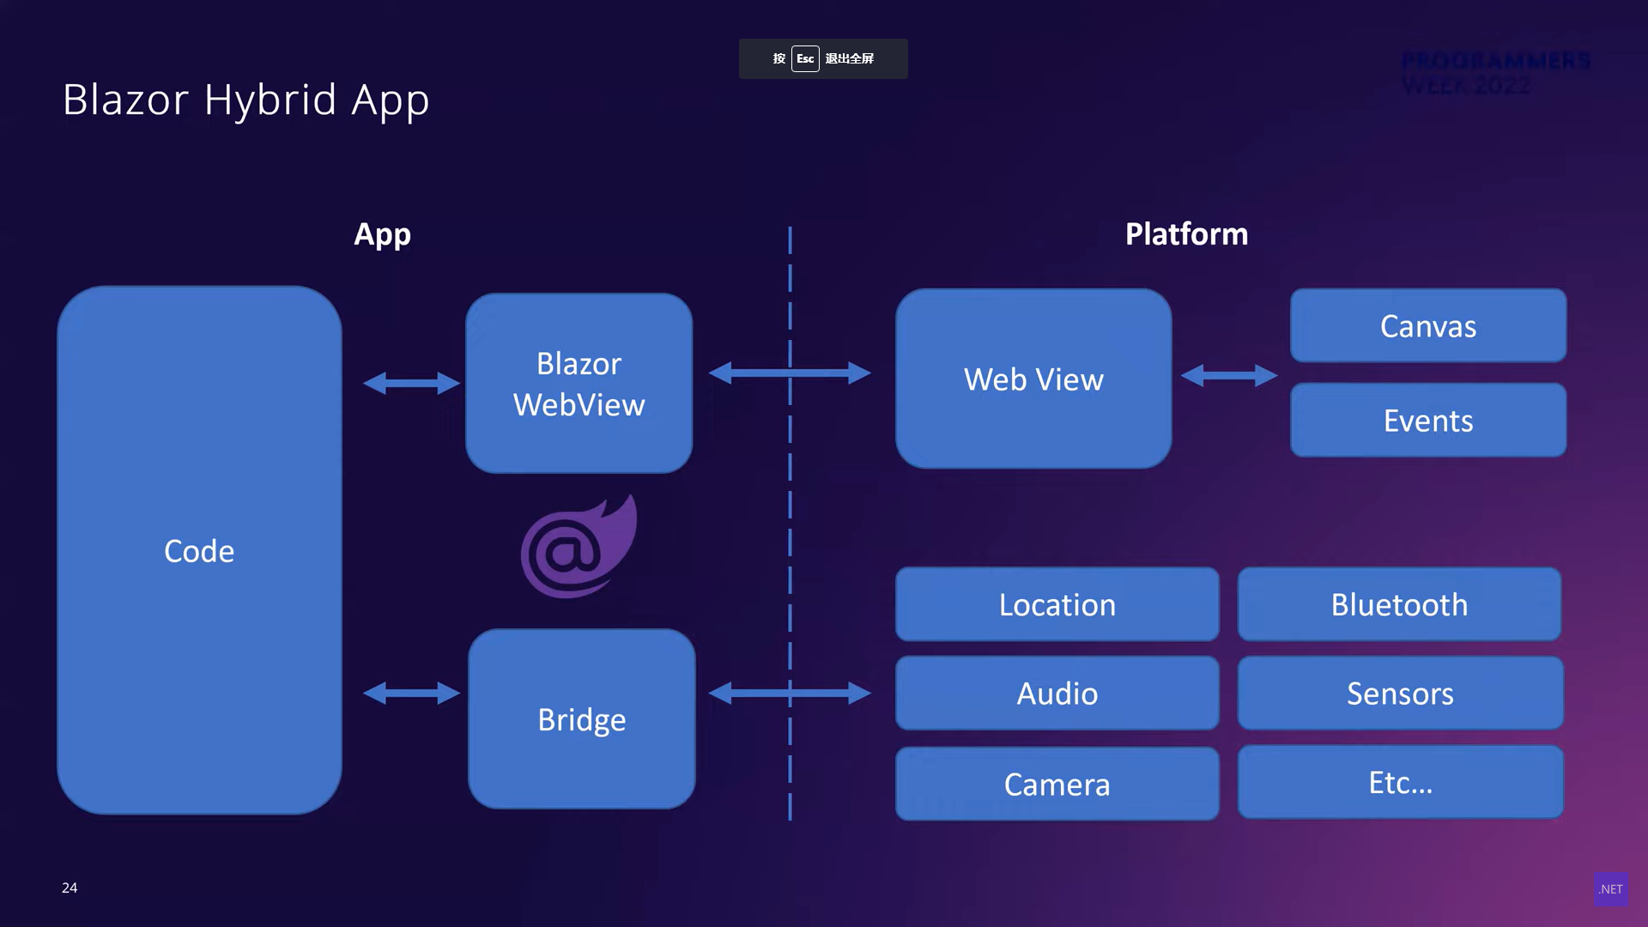

Slide 13
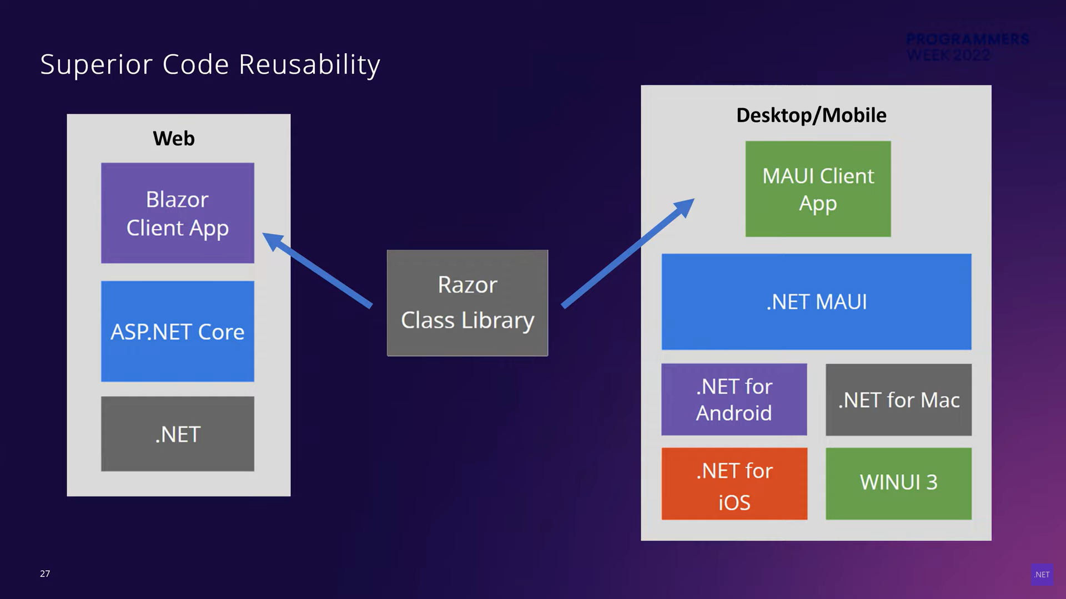

Slide 14
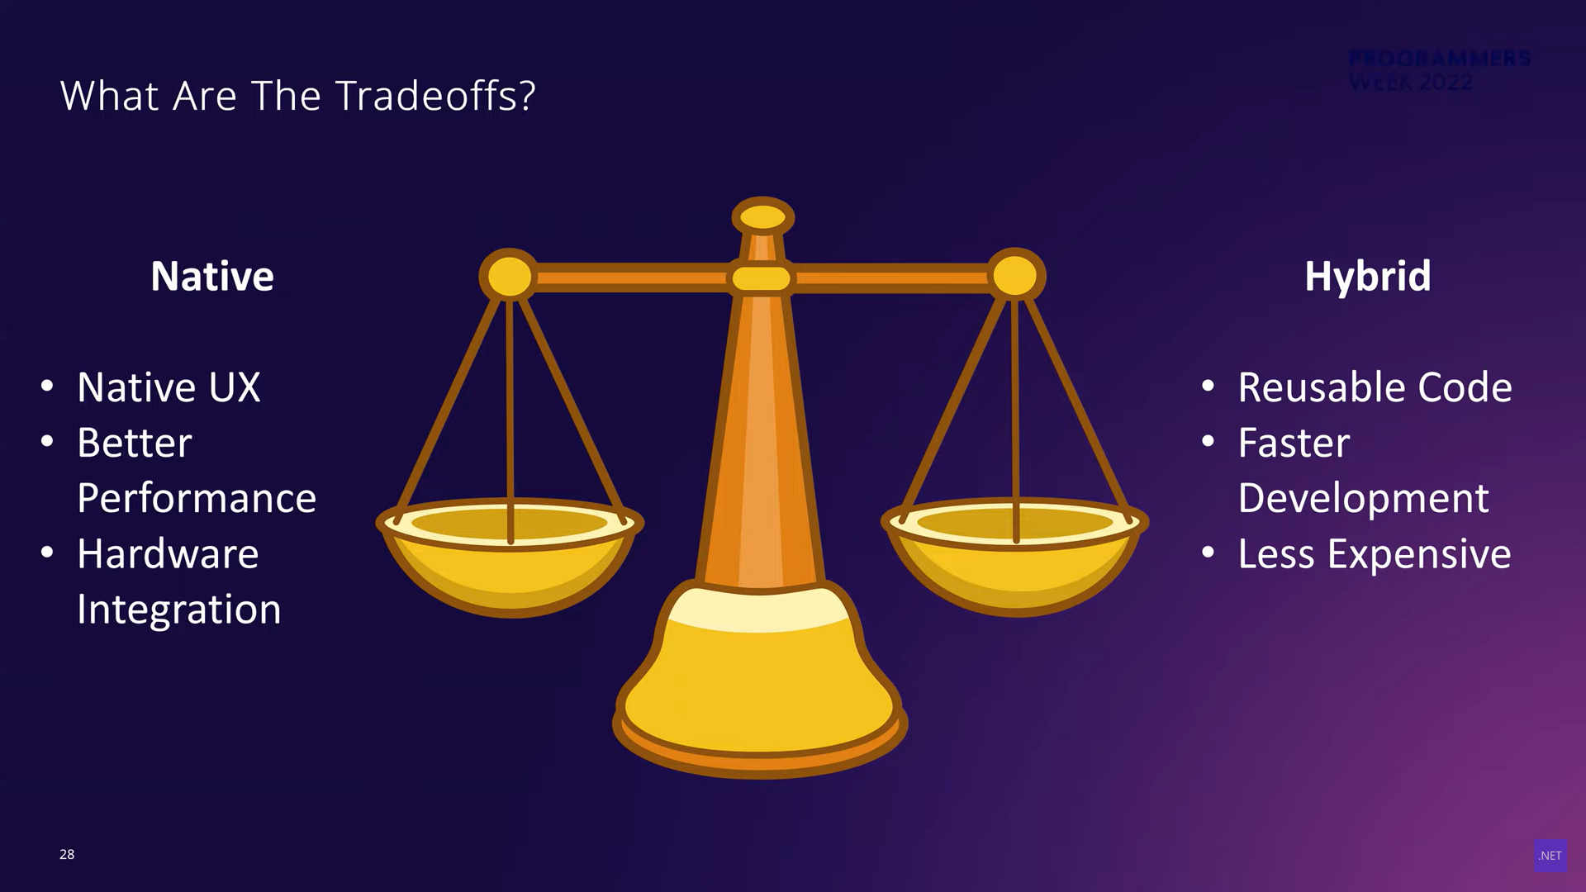

Slide 15
New in .NET 7

Slide 16
Hot-Reload
XAML Hot-Reload
.NET Hot-Reload

Slide 17
Performance Improvements
startup faster
size smaller
scrolling performance - collectionview with 10,000 items

Slide 18
Profiling .NET MAUI
https://github.com/dotnet/maui/wiki/Profiling-.NET-MAUI-Apps
https://www.speedscope.app/

Slide 19
MVVM with Source Generator
https://learn.microsoft.com/zh-cn/dotnet/communitytoolkit/mvvm/generators/overview
https://learn.microsoft.com/zh-cn/dotnet/communitytoolkit/mvvm/
CommunityToolkit.Mvvm Package

